Slide 1
OSI Physical layer
CCNA Exploration Semester 1
Chapter 8

Slide 2
OSI Physical layer
OSI model layer 1
TCP/IP model part of Network Access layer
Application
HTTP, FTP, TFTP, SMTP etc
Presentation
Data stream
Application
Session
Transport
Segment
TCP, UDP
Transport
Network
Packet
IP
Internet
Data link
Frame
Ethernet, WAN technologies
Network Access
Physical
Bits

Slide 3
Physical layer topics
Physical layer protocols and services.
Physical layer signaling and encoding.
How signals are used to represent bits. Characteristics of copper, fiber, and wireless media.
Describe uses of copper, fiber, and wireless network media.

Slide 4
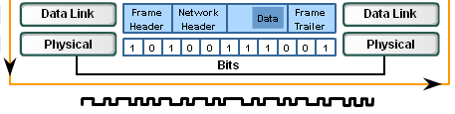
Physical layer tasks
Takes frame from data link layer
Sees the frame as bits – no structure
Encodes the bits as signals to go on the medium

Slide 5
Physical layer standards define:
Physical and electrical properties of the media
Mechanical properties (materials, dimensions, pinouts) of the connectors and NICs
Bit representation by the signals (encoding)
Definition of control information signals

Slide 6
Physical layer standards
Set by engineering institutions
The International Organization for Standardization (ISO)
The Institute of Electrical and Electronics Engineers (IEEE)
The American National Standards Institute (ANSI)
The International Telecommunication Union (ITU)
The Electronics Industry Alliance/ Telecommunications Industry Association (EIA/TIA)

Slide 7
Encoding and signalling
This can be relatively simple at very low speeds with bits being converted directly to signals.
At higher speeds there is a coding step, then a signalling step where electrical pulses are put on a copper cable or light pulses are put on a fibre optic cable.

Slide 8

NRZ - non return to zero
A very simple signalling system
1 is high voltage, 0 is low voltage
Voltage does not have to return to zero during each bit period

Slide 9
NRZ problems
A long string of 1s or 0s can let sender and receiver get out of step with their timing
Inefficient, subject to interference
Straightforward NRZ is not used on any kind of Ethernet, though it could be used if combined with a coding step

Slide 10
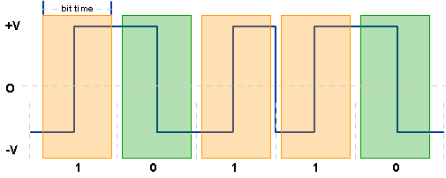
Manchester encoding
Voltage change in the middle of each bit period
Falling voltage means 0, Rising voltage means 1
Change between bit periods is ignored.

Slide 11
Manchester encoding
The transition (up or down) matters, not the voltage level
The voltage change in the middle of each bit period allows the hosts to check their timing
10 Mbps Ethernet uses Manchester encoding (on UTP or old coaxial cables)
Not efficient enough for higher speeds

Slide 12
Two steps
Ethernet varieties of 100Mbps and faster use a coding step followed by converting to signals.
Bits are grouped then coded.
E.g. bits 0011 could be grouped and coded as 10101 (4-bit to 5-bit, 4B/5B). Each possible 4-bit pattern has its own code.
This adds overhead but gives advantages

Slide 13
Advantages of group and code
Control codes such as “start”, “stop” can have codes that are not confused with data
Codes are designed to have enough transitions to control timing
Codes balance number of 1s and 0s – minimise amount of energy put into system
Better error detection – invalid codes are recognised

Slide 14
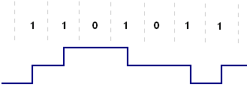
100 Mbps Ethernet on UTP
100 Mbps Ethernet uses 4B/5B encoding first
It then uses MLT-3 to put the bits on the cable as voltage levels
1 means change, 0 means no change

Slide 15

100 Mbps Ethernet on fibre
100BaseFX Ethernet uses 4B/5B encoding first
It then uses NRZI encoding to put flashes of LED infra red light on a multimode fibre optic cable
1 means change, 0 means no change

Slide 16

Gigabit Ethernet on UTP
Uses a complicated coding step followed by a complicated scheme of putting signals on the wires, using 4 wire pairs.

Slide 17
Digital Bandwidth
The amount of data that could flow across a network segment in a given length of time.
Determined by the properties of the medium and the technology used to transmit and detect signals.
Basic unit is bits per second (bps)
1 Kbps = 1,000 bps, 1Mbps = 1,000,000 bps
1 Gbps = 1,000,000,000 bps

Slide 18
Throughput and Goodput
Throughput is the actual rate of transfer of bits at a given time
Varies with amount and type of traffic, devices on the route etc.
Always lower than bandwidth
Goodput measures usable data transferred, leaving out overhead. (headers etc.)

Slide 19
Media
Copper cable (twisted pair and coaxial)
Fibre optic cable
Wireless

Slide 20

Coaxial cable
Central conductor
Insulation
Copper braid acting as return path for current and also as shield against interference (noise)
Outer jacket

Slide 21
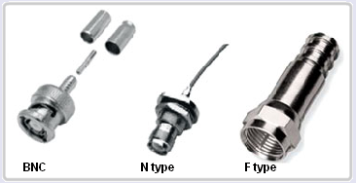
Connectors for coaxial cable

Slide 22
Coaxial cable
Good for high frequency radio/video signals
Used for antennas/aerials
Used for cable TV and Internet connections, often now combined with fibre optic.
Formerly used in Ethernet LANs – died out as UTP was cheaper and gave higher speeds

Slide 23
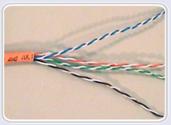
Unshielded twisted pair
(UTP) cable
8 wires twisted together into 4 pairs and with an outer jacket.
Wires have colour-coded plastic jackets
Commonly used for Ethernet LANs

Slide 24
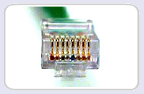
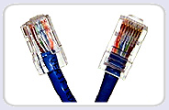
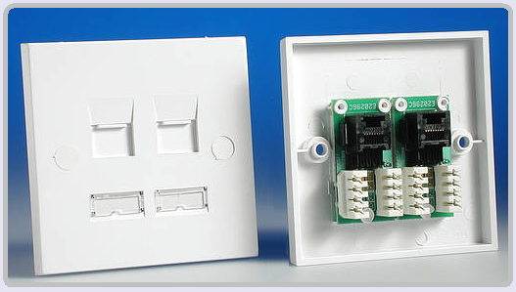
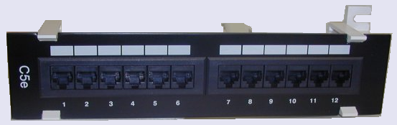
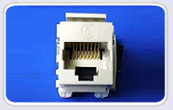
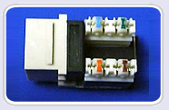
RJ45 connectors
Plugs on patch cables
(crimped)
Sockets to terminate installed cabling
(punch down)

Slide 25
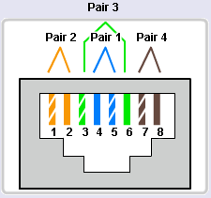
Straight through cable
Both ends the same
Connect PC to switch or hub
Connect router to switch or hub
Installed cabling is straight through

Slide 26
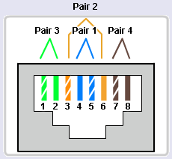
Crossover cable
Wire 1 swaps with 3
Wire 2 swaps with 6
Connect similar devices to each other
Connect PC direct to router

Slide 27
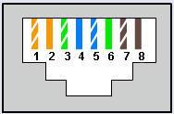
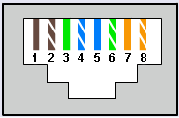
Rollover cable
Cisco proprietary
Wire order completely reversed
Console connection from PC serial port to router – to configure router
Special cable or RJ45 to D9 adaptor.

Slide 28
UTP cable
EIA/TIA sets standards for cables
Category 5 or higher can be used for 100Mbps Ethernet. Cat 5e can be used for Gigabit Ethernet if well installed.
We have Cat 5e. A new installation now would have Cat 6.
The number of twists per metre is carefully controlled.

Slide 29
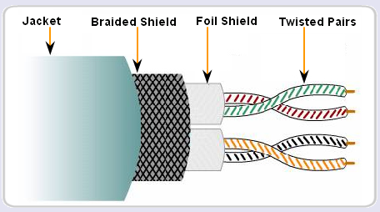
Shielded twisted pair (STP)
Wires are shielded against noise
Much more expensive than UTP
Might be used for 10 Gbps Ethernet

Slide 30
Noise
Electrical signals on copper cable are subject to interference (noise)
Electromagnetic (EMI) from device such as fluorescent lights, electric motors
Radio Frequency (RFI) from radio transmissions
Crosstalk from other wires in the same cable or nearly cables

Slide 31
Avoiding noise problems
Metal shielding round cables
Twisting of wire pairs gives cancelling effect
Avoiding routing copper cable through areas liable to produce noise
Careful termination – putting connectors on cables correctly

Slide 32
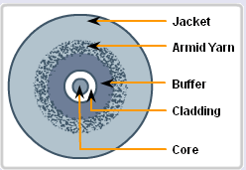
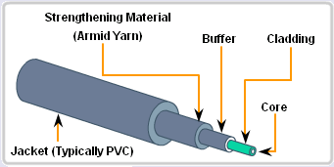
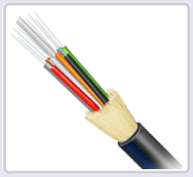
Fibre optic cable
Transmits flashes of light
No RFI/EMI noise problem
Several fibres in cable
Paired for full
duplex

Slide 33

Single mode fibre optic
Glass core 8 – 10 micrometres diameter
Laser light source produces single ray of light
Distances up to 100km
Photodiodes to convert light back to electrical signals

Slide 34

Multimode fibre optic
Glass core 50 – 60 micrometres diameter
LED light source produces many rays of light at different angles, travel at different speeds
Distances up to 2km, limited by dispersion
Photodiode receptors
Cheaper than
single mode

Slide 35





Fibre optic connectors
Straight tip (ST) connector
single mode
Subscriber connector (SC)
multimode
Single mode lucent connector
Multimode lucent connector
Duplex multimode lucent connector (LC)

Slide 36
Which cable for the LAN?
UTP copper | Fibre optic
Max 100 m length Noise problems Within building only Cheaper Easier to install | 100km or 2km No noise problems Within/between buildings More expensive Harder to install

Slide 37
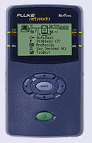
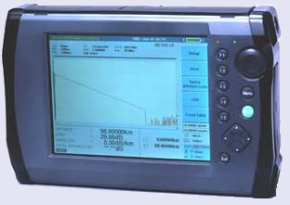
Testing cables
Fluke NetTool for twisted pair cables
Optical Time Domain Reflectometer (OTDR) for fibre optic cables

Slide 38
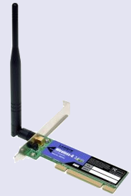
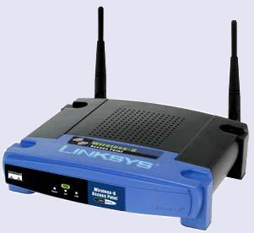
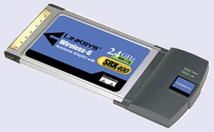
Wireless
Electromagnetic signals at radio and microwave frequencies
No cost of installing cables
Hosts free to move around
Wireless access point
Wireless adaptor

Slide 39
Wireless problems
Interference from other wireless communications, cordless phones, fluorescent lights, microwave ovens…
Building materials can block signals.
Security is a major issue.

Slide 40
Wireless networks
IEEE 802.11 - Wi-Fi for wireless LANs. Uses CSMA/CA contention based media access
IEEE 802.15 - Bluetooth connects paired devices over 1 -100m.
IEEE 802.16 - WiMAX for wireless broadband access.
Global System for Mobile Communications (GSM) - for mobile cellular phone networks.

Slide 41
The End

